Slide 1
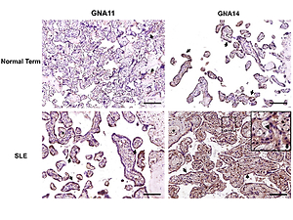

G-protein subunit α-14 is dysregulated in human placentas from systemic lupus erythematosus pregnancies
DOI: 10.5114/aoms/146404
Notes:
Introduction
Systemic lupus erythematosus (SLE) is associated with placental dysfunctions during pregnancy, which may cause multiple adverse fetal and maternal outcomes. G-protein subunits -11 (GNA11) and -14 (GNA14) participate actively in angiogenesis via the modulation of endothelial function. This study aimed to determine whether GNA11 and GNA14 levels in placental tissues differed between SLE and normal term pregnancies.
Material and methods
Twenty-four individuals, including 14 patients with SLE and 10 normal pregnant women, were included in this study. The expression levels of GNA11 and GNA14 in the placentas were examined using reverse transcription-quantitative polymerase chain reaction (RT-qPCR) and Western blotting analyses. The localization of GNA11 and GNA14 in placental tissues was evaluated using immunohistochemistry. The correlations between relative mRNA and protein expression levels of GNA11,14 and the Systemic Lupus Erythematosus Disease Activity Index (SLEDAI) scores were also analyzed.
Results
RT-qPCR revealed that the mRNA levels of GNA14, but not GNA11, were significantly decreased by 50% (p = 0.01) in SLE vs. normal term placentas. Western blotting showed that the protein levels of GNA14, but not GNA11, were significantly increased by 3.52-fold (p = 0.02) in SLE vs. normal term placentas. In immunohistochemistry, positive staining for GNA11 and GNA14 was observed in trophoblasts and villous stromal cells of the placental tissues. The expression levels of GNA11 and GNA14 were not significantly correlated with the SLEDAI scores (r2 = 0.02~0.24, p = 0.08~0.75).
Conclusions
The dysregulation of GNA14 in the placentas indicates a regulatory role during human SLE pregnancies.

