Slide 1
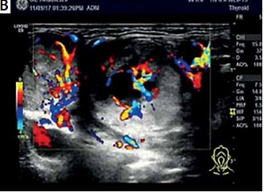

One case of papillary thyroid carcinoma complicated with epidermal follicular carcinoma was followed up for four years
DOI: 10.5114/aoms/146426
Arch Med Sci 2022;18(2):559-563

