Slide 1
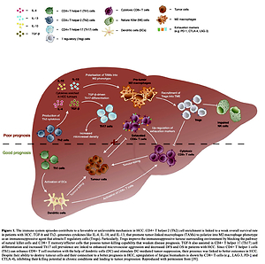

Transcatheter arterial chemoembolization and radiofrequency ablation combined with immunotherapy for hepatocellular carcinoma patients
DOI: 10.5114/aoms/146438
Notes:
Successive trials using immune response checkpoint blockade, the systemic therapy for progressive hepatocellular carcinoma (HCC), have shifted dramatically towards targeting the tumor microenvironment (TME). Locoregional therapies (LRTs) such as radiofrequency ablation (RFA)/rhizotomy, trans-arterial chemoembolization (TACE) and surgical resection in the initial stages are critical. LRTs perform the crucial task of modulating the immune system surrounding the tumor, which is of great importance in the prevailing era of developing immuno-oncology treatments and their direct effect on tumor cells. Significant efforts are needed in exploring the mechanisms of the latest combinational approach to boost the clinical advantage with tolerable side effects. The present review highlights the tumor microenvironment of HCC followed by current immunotherapeutic approaches for HCC. Next, we discuss the concealed mechanisms of LRTs given in combination with immunotherapy and their utilization in clinical practice.

