Slide 1
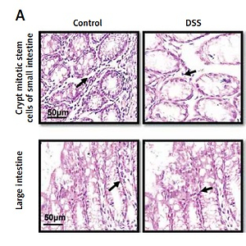

Ibrutinib attenuated DSS-induced ulcerative colitis, oxidative stress, and inflammatory cascade by modulating PI3K/Akt and JNK/NFκB pathways
DOI: 10.5114/aoms/146792
Arch Med Sci 2022;18(3):805-815

