Slide 1
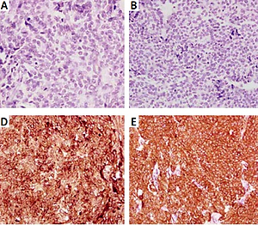

“Triple-negative” non-secretory medullary thyroid cancer: uncommon pathological findings in a rare disease
DOI: 10.5114/aoms/147431
Arch Med Sci 2022;18(3):825-828

