Slide 1
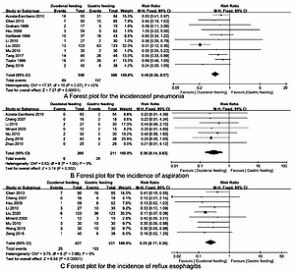

Duodenal versus gastric feeding in patients with traumatic brain injury: a systematic review and meta-analysis
DOI: 10.5114/aoms/147593
Notes:
Introduction
Enteral nutrition support is very important to improve the prognosis of patients with traumatic brain injury (TBI). We aimed to assess the role of duodenal versus gastric feeding in TBI patients, to provide insights into the clinical practice and nursing care.
Material and methods
We searched PubMed and other databases for randomized controlled trials (RCTs) on the role of duodenal versus gastric feeding in TBI patients up to December 15, 2021. The Cochrane Collaboration risk of bias tool was used to assess the methodological quality and risk of bias of included studies. The RevMan 5.3 software was used for data analysis, risk rate (RR) or mean differences (MDs) with 95% confidence interval (CI) were calculated, and publication bias was evaluated by funnel plots.
Results
A total of 16 RCTs were included in this meta-analysis. Synthesized outcomes indicated that compared with gastric feeding, duodenal feeding is beneficial to reduce the incidence of pneumonia (RR = 0.46, 95% CI: 0.38, 0.57), aspiration (RR = 0.30, 95% CI: 0.14, 0.63), reflux esophagitis (RR = 0.25, 95% CI: 0.17, 0.38), diarrhea (RR = 0.58, 95% CI: 0.44, 0.77), and abdominal distension (RR = 0.41, 95% CI: 0.25, 0.68); no significant difference in mortality (RR = 0.85, 95% CI: 0.50, 1.47, p = 0.57) was found. Egger’s regression test indicated that there was no publication bias in the synthesized outcomes (all p > 0.05).
Conclusions
Duodenal feeding may be superior to gastric feeding in the treatment and nursing care of TBI patients with fewer complications. Future studies with a larger sample size and rigorous design are needed to further elucidate the effects and safety of duodenal versus gastric feeding.

