Slide 1
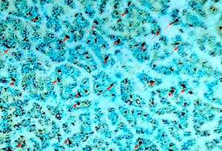

Multiple endocrine neoplasia type 1 with ectopic parathyroid adenoma
DOI: 10.5114/aoms/147737
Arch Med Sci 2022;18(3):829-832

