Slide 1
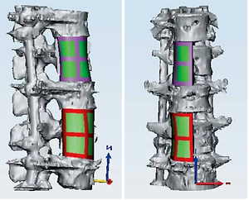

Application of three-dimensional printing technology for spinal tuberculosis
DOI: 10.5114/aoms/148090
Arch Med Sci 2022;18(3):833-837

