Slide 1
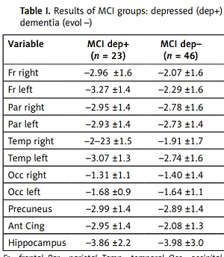

Depressive symptoms in amnesic mild cognitive impairment: an FDG-PET/CT study
DOI: 10.5114/aoms/149717
Arch Med Sci 2022;18(4):1108-1111
Notes:
Introduction
The detection in mild cognitive impairment (MCI) of metabolic alterations suggestive of depression and/or of evolution to dementia.
Material and methods
Sixty-nine MCI patients underwent clinical and imaging evaluation including position emission tomography/computed tomography with fluorodeoxy-glucose (FDG-PET/CT).
Results
The metabolism mean values in parietal, temporal and pre-cuneus areas were lower in subjects who evolved to dementia, and in frontal and in anterior cingulate areas in depressed subjects. Abnormal metabolism values were higher in the frontal and parietal lobes, and in the precuneus in subjects who evolved to dementia independently from depression.
Conclusions
In MCI FDG-PET/CT abnormality patterns suggest the presence of depression or the evolution to dementia.

