Slide 1
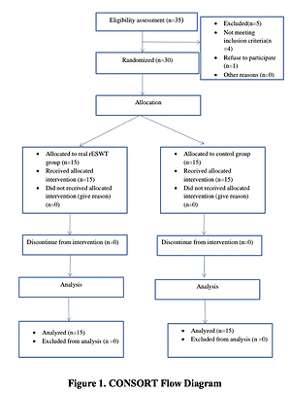

The influence of radial extracorporeal shock wave therapy on shoulder pain and structural abnormalities in stroke patients
DOI: 10.5114/aoms/151477
Arch Med Sci 2023;19(6):1731-1738
Notes:
Introduction
Structural abnormalities in the shoulder joint are a common complication post stroke, and the consequent pain and functional limitations become devastating quality of life problems for such patients. Shock wave therapy is a non-invasive method that can enhance the level of perfusion in ischaemic tissues, relieve inflammation, and promote healing. The aim of the study was to examine the efficacy of radial extracorporeal shock wave therapy (rESWT) on pain and disability levels in stroke patients with shoulder structural abnormalities.
Material and methods
Thirty subacute stroke patients aged between 40 and 60 years were randomly allocated into 2 equal groups after signing an institutional consent form. The real rESWT group (GA) underwent rESWT in addition to a designed program of physical therapy to the shoulder joint. The control group (GB) received sham rESWT in addition to the same physical therapy program as for GA. The treatment protocol for both groups was 2 times per week for a month. Baseline and post-intervention findings in both groups were assessed and compared for primary outcomes including shoulder structural changes, pressure pain threshold (PPT), and shoulder disability, measured by ultrasonography (USS), a handheld algometer, and the shoulder pain disability index (SPADI), respectively.
Results
Significant reduction of all post-treatment SPADI scores (pain, disability, and total scores) in both groups with a remarkable decrease in the rESWT group (GA) (p < 0.05). In addition, USS scores and PPT findings showed notable preference in favour of the GA group, which was demonstrated as significant decrease in USS score with an increase in PPT findings only in the rESWT group (GA) (p < 0.05).
Conclusions
The addition of radial extracorporeal shock wave therapy (rESWT) to a designed physical therapy program is more efficient in reducing shoulder structural abnormalities, pain, and disability in subacute stroke patients.

