Slide 1
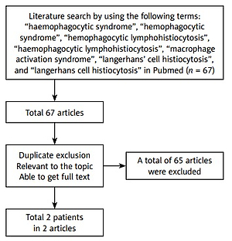

Langerhans cell histiocytosis in the adult with hemophagocytic lymphohistiocytosis
DOI: 10.5114/aoms/151478
Arch Med Sci 2022;18(5):1426-1428

