Slide 1
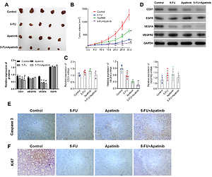

Synergistic antitumor effects of 5-FU and Apatinib on papillary thyroid cancer in vitro and in vivo
DOI: 10.5114/aoms/151770
Notes:
Introduction
Papillary thyroid carcinoma (PTC) is the most common type of thyroid malignancy with increased incidence rapidly occurring in most countries. The study aimed to investigate the antitumor effects of the combination of 5-FU and Apatinib on PTC.
Material and methods
TPC-1 and SW579 cells were treated with 5-FU, Apatinib, or a combination of 5-FU and Apatinib. Cell viability was assessed by the CCK-8 assay. Edu staining and colony formation were used to evaluate the cell proliferation ability. Flow cytometry was used to analyze the cell apoptosis. Wound healing and the Transwell assay were conducted to analyze cell migration and invasion. The angiogenesis of TPC-1 and SW579 cells was assessed by conducting the tube formation assay. Xenograft tumor models were established by injecting TPC-1 cells into nude mice. Expressions of CD31, VEGFA, and VEGFR2 were determined using immunofluorescence and Western blotting.
Results
Compared with 5-FU or Apatinib treatment alone, the combination of 5-FU and Apatinib produced stronger suppressive effects on cell proliferation, migration, invasion, and angiogenesis. An in vivo experiment showed that the combination of 5-FU and Apatinib strongly suppressed tumor growth. The combination of 5-FU and Apatinib remarkably suppressed expressions of CD31, VEGFA, and VEGFR2, associated with angiogenesis.
Conclusions
Our data demonstrated that 5-FU combined with Apatinib therapy obtained synergistic antitumor effects in PTC, compared with either 5-FU or Apatinib alone by down-regulating VEGFA/VEGFR2 signaling pathways.

