Slide 1
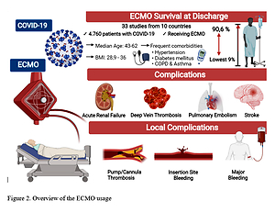

The use of extracorporeal membrane oxygenation in COVID-19: a systematic review
DOI: 10.5114/aoms/152022
Arch Med Sci 2025;21(3):897-918
Notes:
Introduction
The COVID-19 pandemic represents a major worldwide challenge, with a great impact on health systems and economic mechanisms. SARS-CoV-2, the pathogenic agent that generates COVID-19, creates a wide variety of organ dysfunctions, from acute respiratory distress syndrome (ARDS) to acute myocardial infarction or pulmonary embolism. Mechanical circulatory support devices such as extracorporeal membrane circulatory oxygenation (ECMO) have shown their efficacy in maintaining organ perfusion in respiratory and cardiac impairments. With this review, we aimed to assess the impact of ECMO use in COVID-19 patients with ARDS.
Material and methods
We performed a systematic review to find studies using ECMO in COVID-19. Comorbidities, side effects, and survival rate to discharge were analysed. The literature search was done using PubMed/MEDLINE, Web of Science, Embase (Elsevier), the Cochrane Central Register of Controlled Trials (Wiley) and clinicaltrials.gov databases (inception (December 2019) to October 16, 2021), by 2 authors.
Results
We included 33 studies from 10 countries with a total of 4760 patients receiving ECMO for COVID-19. The survival rate varied from 9% to 90.6% at discharge. The most serious adverse events were acute kidney injury (up to 87%), major bleeding (up to 92.1%), strokes or cerebral haemorrhage (up to 34%). Other complications such as pulmonary embolism, peripheral bleeding, or sepsis had a major impact on survival rates.
Conclusions
ECMO in COVID-19 patients may be a useful rescue therapy instrument, but due to the great variability of studies and still unknown mechanisms and effects of SARS-CoV-2, further studies need to be done.

