Slide 1
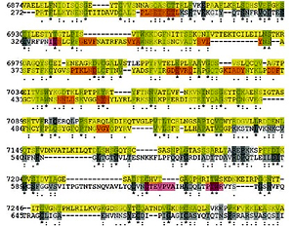

mRNA vaccination in children and youth: a cautionary note
DOI: 10.5114/aoms/152279
Arch Med Sci 2022;18(5):1404-1406

