Slide 1
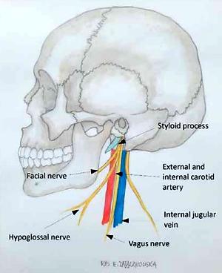

Eagle’s syndrome: one cause, many problems. Presentation of a series of clinical cases with headaches and increased risk of stroke
DOI: 10.5114/aoms/152753
Arch Med Sci 2022;18(5):1420-1422

