Slide 1
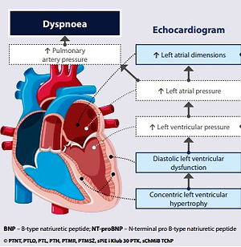

Metabolic syndrome – a new definition and management guidelines.
A joint position paper by the Polish Society of Hypertension, Polish Society for the Treatment of Obesity, Polish Lipid Association, Polish Association for Study of Liver, Polish Society of Family Medicine, Polish Society of Lifestyle Medicine, Division of Prevention and Epidemiology Polish Cardiac Society, “Club 30” Polish Cardiac Society, and Division of Metabolic and Bariatric Surgery Society of Polish Surgeons
DOI: 10.5114/aoms/152921
Arch Med Sci 2022;18(5):1133-1156

