Slide 1
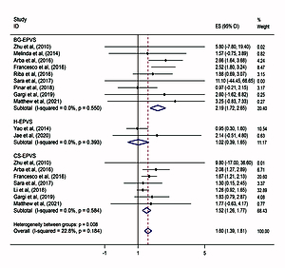

Associations between enlarged perivascular spaces and clinical manifestations: a meta-analysis
DOI: 10.5114/aoms/152945
Arch Med Sci 2026;22(4):2025-2037
Notes:
Introduction
Enlarged perivascular spaces (EPVS) are ubiquitous in the elderly and have an insidious onset. Their correlation with clinical symptoms is easily overlooked and controversial. We conducted a meta-analysis to investigate the clinical outcomes associated with EPVS.
Material and methods
Relevant studies published up to April 2022 were extracted from PubMed, Embase, Cochrane, OVID, and Web of Science. Odds ratios (ORs) and 95% confidence intervals (CIs) were used to estimate the strength of the associations.
Results
Of the 6622 articles identified, 32 studies were eligible, including a total of 19,987 people. EPVS were associated with an increased risk of cognitive impairment (OR = 1.60, 95% CI: 1.39–1.81), motor impairment (OR = 2.24, 95% CI: 1.22–3.25), sleep disturbance (OR = 1.81, 95% CI: 1.34–2.28), and depressive symptoms (OR = 1.54, 95% CI: 1.14–1.95), but was not significantly associated with the occurrence of stroke (OR = 0.97, 95% CI: 0.74–1.21). Results of subgroup analysis showed that basal ganglia (BG) EPVS were more strongly associated with cognitive impairment (OR = 2.19, 95% CI: 1.72–2.65) and sleep disturbance (OR = 1.74, 95% CI: 1.20–2.29).
Conclusions
Our findings suggest that EPVS are associated with cognitive impairment, motor impairment, sleep disturbance, and depressive symptoms. These findings may provide a basis for further investigation of the clinical significance of EPVS.

