Slide 1
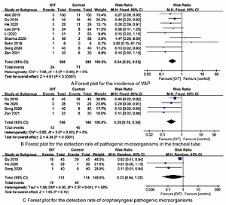

Oral immunotherapy prevents ventilator-associated pneumonia in premature infants: a meta-analysis and systematic review
DOI: 10.5114/aoms/153470
Notes:
Introduction
Ventilator-associated pneumonia (VAP) prevention and care is essential to the prognosis of premature infants. We aimed to evaluate the effects and safety of oral immune therapy (OIT) in premature infants, to provide evidence for the clinical treatment and nursing care of premature infants.
Material and methods
We systematically searched PubMed, Embase, Cochrane Library, Web of Science, Cumulative Index of Nursing and Allied Health Literature (CINAHL), China National Knowledge Infrastructure (CNKI), China Biomedical Documentation Service (CBM), Wanfang databases for randomized controlled trials (RCTs) on the effects and safety of OIT in preterm infants until July 16, 2022. Two researchers independently screened the literature and extracted data. Revman 5.3 software was used for data meta-analysis.
Results
10 RCTs involving 852 premature infants were included, 427 premature infants received OIT. Synthesized outcomes showed that OIT reduced the incidence of VAP [RR=0.34, 95%CI (0.22-0.53)], the detection rate of tracheal tube-causing microorganisms [RR=0.29, 95%CI (0.16-0.50)] and length of hospital stay [MD=-6.60, 95%CI (-11.66, -1.53)] in premature infants (all P<0.05). There were no statistically differences in the detection rate of oropharyngeal pathogenic microorganisms [RR=0.23, 95%CI (0.04-1.32)], duration of mechanical ventilation [MD=-0.67, 95%CI (-1.37, 0.03)], mortality [RR=0.60, 95%CI (0.31, 1.14)] between OIT and control group (all P>0.05).
Conclusions
OIT is a simple and effective nursing method, which provides a new approach for the prevention of VAP in premature infants. RCTs with high quality, larger sample size and multi-centers are still needed for further verification on the role of OIT in the future.

