Slide 1
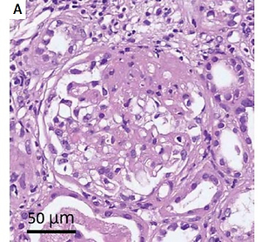

Relapsed focal segmental glomerulosclerosis and severe acute kidney injury after Oxford-AstraZeneca (AZ) COVID-19 vaccine
DOI: 10.5114/aoms/153477
Arch Med Sci 2022;18(6):1693-1695

