Slide 1
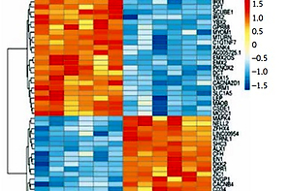

Changes of mRNA expression underlying orbital adipogenesis in thyroid-associated orbitopathy
DOI: 10.5114/aoms/153478
Arch Med Sci 2022;18(6):1708-1715

