Slide 1
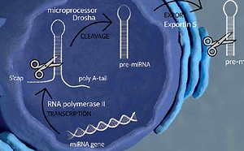

The diagnostic potential of novel biomarkers of hypertension in men
DOI: 10.5114/aoms/153500
Arch Med Sci 2022;18(6):1666-1671
Notes:
Introduction
The present study aimed to evaluate the diagnostic usefulness of selected novel parameters as biomarkers of hypertension: miR-145-5p, miR-1-3p, miR-423-5p, PCSK9, MyBPC3, NOX1, CYBb, and NCF2, DNase 1, anti-MPO and anti-PR3 antibodies.
Material and methods
We present the data of men with normal blood pressure, diagnosed hypertension, confirmed hypertension, hypertension and coexisting coronary artery disease.
Results
Elevated levels of miR-145-5p, miR-1-3p, and miR-423-5p and high levels of PCSK9, MyBPC3, DNase 1 were observed in all groups of hypertensive men. We showed decreased levels of NOX1 and CYBb, with elevated level of NCF2.
Conclusions
PCSK9 shows the greatest potential as an early biomarker of screening-detected hypertension.

