Slide 1
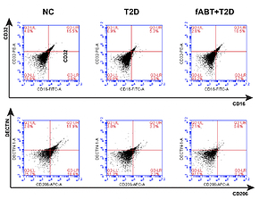

Fresh autologous blood transfusion reverses erythrocytes damage by reducing oxidative stress via promoting mitochondrial metabolism and M2 macrophages polarization
DOI: 10.5114/aoms/154020
Arch Med Sci 2025;21(5):2136-2143
Notes:
Introduction
Systemic inflammatory and immunosuppressive incidents constitute a significant hallmark of the adverse effects of RBC transfusion on red blood cells. These adverse side effects are seemingly associated with old blood transfusions; therefore, we aimed to investigate the underlying mechanism of fresh autologous blood transfusion (fABT) and its subsequent effect in diabetic mice.
Material and methods
In the present in vivo study, we utilized 60 Swiss male mice aged 6–8 weeks, categorized as normal, diabetic, and freshly transfused with autologous blood. After treating the mice accordingly, further experimentations took place as we assessed the M1/M2 macrophage polarization concerning CD16/CD32/CD206 cells by flow cytometry, determined the mitochondrial metabolism using Lowry’s method, measured hepatic oxidative stress using MDA and SOD assays, and examined the erythrocytic oxygen-carrying capacity (Q value) and oxygen consumption rate (OCR) and osmotic fragility.
Results
The results showed that fresh autologous blood transfusion markedly reduced M2 macrophage polarization, enhanced hepatic mitochondrial metabolism, reduced hepatic oxidative stress, and promoted the oxygen-carrying capacity of red blood cells while reducing osmotic fragility and oxygen consumption. Moreover, we found that fABT promoted the IGF2/PI3K signaling pathway, indicating the vital necessity of providing fresh autologous blood transfusion during therapy or surgery.
Conclusions
Our results are the first to highlight the underlying mechanism by which fABT modulates physiological patterns in a diabetic animal model, and provide a sound basis for utilizing fABT in clinical applications.

