Slide 1
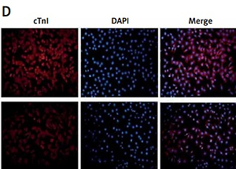

MiRNA-21 promotes differentiation of bone marrow mesenchymal stem cells into cardiomyocyte-like cells by regulating the Ajuba/Isl1 axis pathway
DOI: 10.5114/aoms/154956
Arch Med Sci 2022;18(6):1672-1677
Notes:
Introduction
In this study, we aimed to investigate the role of miRNA-21 and the regulating pathway that promotes the differentiation of bone marrow mesenchymal stem cells (BMSCs).
Material and methods
We used miR-21-OE, miR-21-KD, ajuba-OE and ajuba-KD plasmids to infect BMSCs. The expression of miRNA-21, ajuba, Isl1 and cTnI was detected by RT-qPCR, WB and immunofluorescence staining in groups.
Results
MiRNA-21 over-expression increased the expression of Isl1, and vice versa. Ajuba over-expression decreased the expression of Isl1, and vice versa. Ajuba negatively regulated the differentiation of BMSCs into cardiomyocyte-like cells.
Conclusions
MiRNA-21 could regulate differentiation of bone marrow mesenchymal stem cells (BMSCs) to cardiomyocyte-like cells through the ajuba/Isl1 axis pathway.

