Slide 1
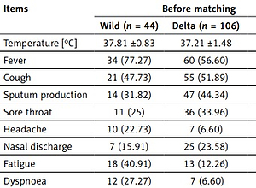

A comparison of the protective effect of vaccination and clinical features between the SARS-CoV-2 wild-type strain and Delta (B.1.617.2) variant
DOI: 10.5114/aoms/155114
Arch Med Sci 2022;18(6):1678-1682
Notes:
Introduction
This study aimed to investigate the clinical features and vaccine effectiveness of patients with the SARS-CoV-2 wild-type strain and the Delta variant.
Material and methods
We retrospectively evaluated patients with the SARS-CoV-2 wild-type strain and the Delta variant.
Results
The Delta-variant group showed a higher infection rate in minors, who had higher incidence of anosmia or dysgeusia and shorter incubation period. Unvaccinated patients had a 15.59-fold higher risk of severe classification than vaccinated patients. The viral clearance time was significantly shorter in the Delta-variant group.
Conclusions
The Delta-variant group show higher transmissibility, and vaccination reduces the incidence of severe classification and promotes viral clearance.

