Slide 1
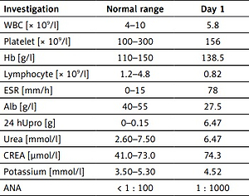

Case report of systemic lupus erythematosus in a middle-aged male with facial palsy at onset
DOI: 10.5114/aoms/155115
Arch Med Sci 2022;18(6):1696-1699

