Slide 1
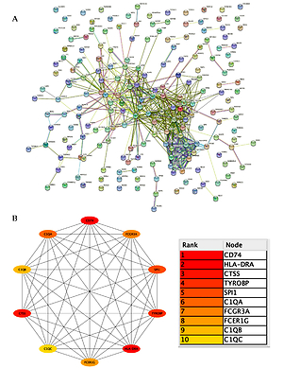

Bioinformatics analysis and experiments identify CD74 as a potential immune target in ovarian carcinoma
DOI: 10.5114/aoms/155116
Notes:
Introduction
Ovarian carcinoma (OC) is one of the most common malignancies in women worldwide.Immune checkpoint inhibitors are routinely used to treat OC, but with little clinical success.Here,we aimed to explore novel immune-effective biomarkers for OC management.
Material and methods
Datasets from The Cancer Genome Atlas,Genotype-Tissue Expression, and the Clinical Proteomic Tumor Analysis Consortium were used to identify hub genes significantly associated with CD8+ T effectors and immune checkpoint signatures and to explore the potential oncogenic role of CD74 in OC.The immune checkpoint construct inhibitor score (IMS) was constructed to predict immunotherapy responsiveness and prognosis.CD74 expression was further validated using immunohistochemistry in OC tissues.
Results
The yellow gene module showed a significant correlation with the CD8+ T effector and immune checkpoint profiles.Functional enrichment analysis showed that the yellow gene module was associated with immune response and antigen binding.Thus, IMS can accurately predict immunotherapy responsiveness and prognosis.In addition,CD74 was significantly upregulated at both the mRNA and protein levels in OC, and the high expression of the CD74 protein was related to the activation of various tumor-related pathways. Kaplan-Meier analysis showed that high CD74 expression correlated with poor prognosis in OC.Furthermore,CD74 expression remarkably correlated with inflammatory cytokines,immune cells,the tumor immune microenvironment, and immune checkpoints.Finally,CD74 expression in pericarcinomatous and cancer tissues from OC patients was verified via IHC analysis,which corresponded to the public database results (all p < 0.05).
Conclusions
CD74 may represent a novel immune biomarker to predict the prognosis of OC patients,as well as a potential therapeutic target related to immunotherapy,providing new ideas for the treatment of OC.

