Slide 1
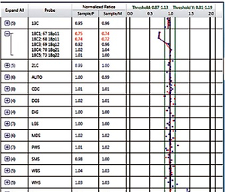

Extended application of BACs-on-Beads technique in prenatal diagnosis
DOI: 10.5114/aoms/155981
Arch Med Sci 2023;19(1):250-257
Notes:
Introduction
This study explored the application of bacterial artificial chromosomes (BACs)-on-Beads (BoBs) technique, especially its ability to detect microdeletion/microduplication regions with a single probe.
Material and methods
Both chromosome karyotyping and BoBs technique were applied on a total of 2218 pregnant women. Chromosome microarray analysis (CMA) was performed on patients whose cells were reported as being abnormal by BoBs technique with a single probe.
Results
Twenty-two cases were detected as microdeletion/microduplication with a single probe, which was consistent with the CMA results.
Conclusions
We believe that the microdeletion/microduplication results detected by BoBs technique with a single probe provide comprehensive guidance for prenatal diagnosis.

