Slide 1
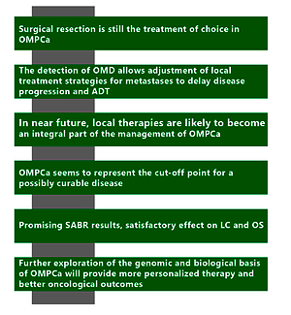

Oligometastatic Disease in Prostate Cancer. Evolving paradigm: current knowledge, diagnostic techniques and treatment strategies
DOI: 10.5114/aoms/156170
Notes:
Although the oligometastatic type of prostate cancer (PCa) is the subject of much research, it still has no clear biological and clinical specification. It is a condition between localized and extensive PCa, in which early diagnosis and treatment are favorable prognostic factors. Not so long ago, just the presence of metastases was considered a poor prognosis with limited therapeutic options. Such patients were treated as if they had advanced cancer and received hormonal treatment. However, clinical trials have shown that Androgen Deprivation Therapy (ADT) can be delayed in patients with an oligometastatic PCa (OMPCa). New therapeutic methods are being developed thanks to the advanced research and various concepts to understand the underlying biology of this type of cancer. In this review, the intention is to bring together the latest information in this domain.

