Slide 1
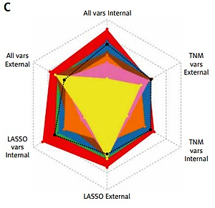

Deep learning survival model for colorectal cancer patients (DeepCRC) with Asian clinical data compared with different theories
DOI: 10.5114/aoms/156477
Arch Med Sci 2023;19(1):264-269
Notes:
Introduction
Colorectal cancer (CRC) is the third most common cancer. Precise prediction of CRC patients’ overall survival (OS) probability could offer advice on its treatment. Neural network (NN) is the first-class algorithm, but a consensus on which NN survival models are better has not been established yet. A predictive model on CRC using Asian data is also lacking.
Material and methods
We conducted 8 NN survival models of CRC (n = 416) with different theories and compared them using Asian data.
Results
DeepSurv performed best with a C-index value of 0.8300 in the training cohort and 0.7681 in the test cohort.
Conclusions
The deep learning survival model for CRC patients (DeepCRC) could predict CRC’s OS accurately.

