Slide 1
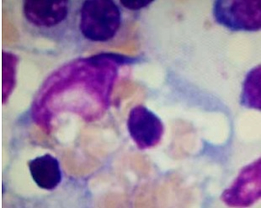

Hemophagocytic lymphohistiocytosis in a 26-year-old male
DOI: 10.5114/aoms/158536
Arch Med Sci 2023;19(1):302-304

