Slide 1
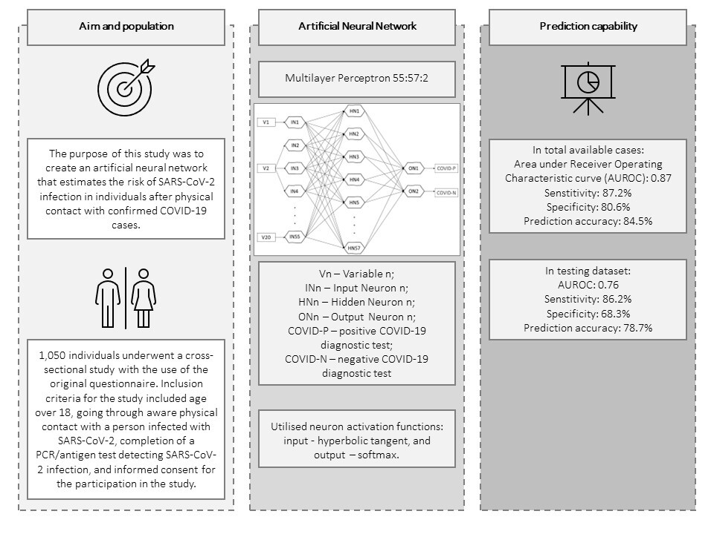

The possibilities of prospective assessment of SARS-CoV-2 infection risk based on an artificial neural network model – a cross-sectional and <i>in silico</i> study
DOI: 10.5114/aoms/159342
Arch Med Sci 2025;21(3):836-844
Notes:
Introduction
The prediction of how an infection of a new pathogen, such as SARS-CoV-2, will evolve using traditional modelling methods may turn out to be unattainable, although it could be achievable using in silico techniques. The purpose of this study was to create an artificial neural network that estimates the risk of SARS-CoV-2 infection in individuals after physical contact with confirmed COVID-19 cases.
Material and methods
A cross-sectional study was conducted with an original 118-item questionnaire. Information concerning participants’ demographics, the circumstances of the contact with an infected person, general medical history, lifestyle, preventive behaviours, and the result of the COVID-19 test after the contact was obtained. The study included 1050 participants. The data were used to train and validate an artificial neural network. The project was funded by the Ministry of Education and Science as part of the “Studenckie Koła Naukowe Tworzą Innowacje” student competition (project no. SKN/SP/496779/2021).
Results
The model in the analysis of total available cases had an area under the receiver operating characteristic curve (AUROC) of 0.87, sensitivity of 87.2%, specificity of 80.6% and prediction accuracy of 84.5%. The model shows a high capacity for generalisation – in the testing data set: AUROC 0.76, sensitivity 86.2%, specificity 68.3%, prediction accuracy 78.7%.
Conclusions
The developed tool is capable of high quality generalisation of the collected data, which translates into its ability to assess the risk of SARS-CoV-2 infection in a person after contact with a COVID-19 case. It has been deployed as an online calculator available on: https://www.umlub.pl/uczelnia/struktura-organizacyjna/szczegoly,317.html

