Slide 1
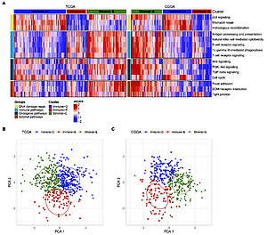

Identification and validation of immune pathway subtyping in glioblastoma to predict clinical prognosis and immunotherapy response in patients
DOI: 10.5114/aoms/159344
Notes:
Introduction
Glioblastoma (GBM) as a frequently diagnosed primary intracranial tumor has a significantly poor prognosis. Only a few studies have probed into the immune profile associated with GBM. This study explored the role of immune features of GBM in prognosis and immunotherapy response.
Material and methods
GBM samples were subtyped by evaluating 15 immune-related pathways and genes using consensus clustering. GISTIC2 analyzed copy number variations and the impute package was used to perform methylation analysis. Immune characteristics were unveiled by using ssGSEA, ESTIMATE, and CIBERSORT. Immunotherapy and chemotherapeutic drug responses were calculated with the TIDE and pRRophetic package respectively. Weighted gene co-expression network analysis (WGCNA), Cox regression, Lasso, and stepAIC were used to develop a prognostic immune score (IMscore) model.
Results
GBM was categorized into 3 subtypes: immune-deprived (Immune-D) (low enrichment of immune pathways and high enrichment of DNA damage repair pathways); stromal-enriched (Stromal-E) (high enrichment of immune pathways, oncogenic pathways and stromal pathways); and immune-enriched (Immune-E) (low enrichment of DNA damage repair pathways and high enrichment of immune pathways). Methylation differences were found in TWIST1, CDH2 and CDH1 among 3 subtypes. Immune-E responded better to immunotherapy, while Immune-D was more sensitive to chemotherapeutic drugs. This study established a prognostic model with five genes (OSMR, SPP1, CUL1, CTBP2, NGFR) for GBM.
Conclusions
Three subtypes had different prognosis and response to immunotherapy and chemotherapy. A five-gene prognostic model was robust to predict prognosis in GBM as well as pan-cancer. The subtyping and prognostic model may facilitate individualized prognosis management and personalized therapeutic intervention.

