Slide 1
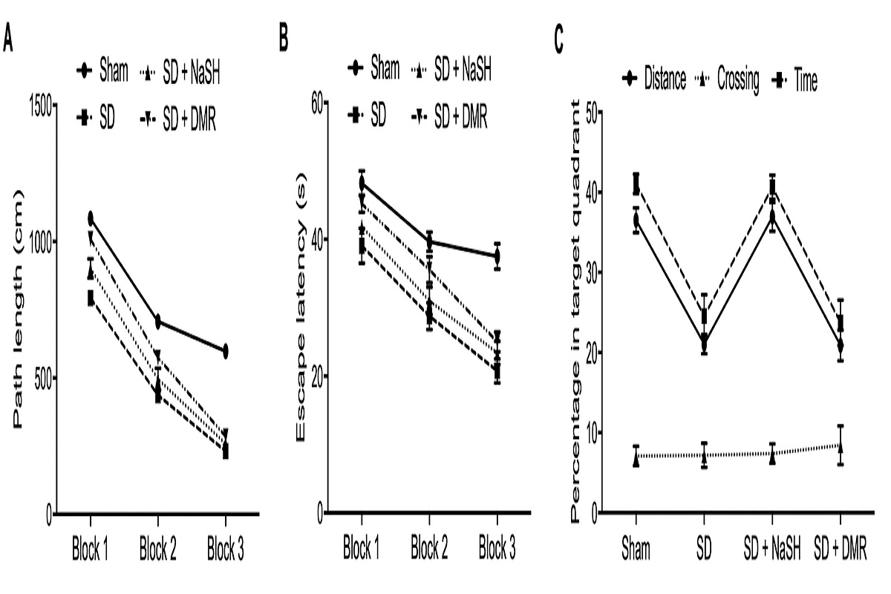

Dietary methionine restriction attenuates cognitive dysfunction associated with sleep deprivation by promoting production of hydrogen sulfide, upregulating expression of BDNF and suppressing neuro-inflammation in rats
DOI: 10.5114/aoms/160047
Notes:
Introduction
In this study, we aimed to study the potential role of H2S and the application of dietary methionine restriction (DMR) in the treatment of cognitive dysfunction in sleep deprived rat models.
Material and methods
The rat groups were established as a Control group, a sleep deprivation (SD) group, a SD + NaSH group and a SD + DMR group. Behavioral data was studied via Morris water maze test. TUNEL assay, real-time PCR, immunohistochemistry (IHC) and enzyme-linked immunosorbent assay (ELISA) were performed to study the differences of cognitive impairment related genes and proteins in different rat groups.
Results
Path length and escape latency were higher in the sleep deprived rats compared with the control rats, which were subsequently recovered by the treatment of NaSH or DMR. Also, DMR most significantly recovered the cognitive impairment and neuron status of sleep deprived rats compared with the administration of NaSH. The elevated level of hippocampal Iba1 and H2S production was recovered by NaSH and DMR, and the expressions of hippocampal phenotypic-related genes including NOS, CD68, CD32 and CD206 mRNA also showed similar trend as hippocampal Iba1. Meanwhile, the increased relative expression of IL-6 and IL-4 were recovered by DMR in sleep deprived rats, while the reduced level of hippocampal brain-derived neurotrophic factor (BDNF) and cystathionine γ-lyase (CSE) were elevated by the treatment of NaSH and MDR, with MDR exhibiting the most significant effect.
Conclusions
The application of DMR could attenuate cognitive dysfunction in sleep deprivation rats by upregulating the production of H2S and BDNF expression and alleviating neuro-inflammation responses.

