Slide 1
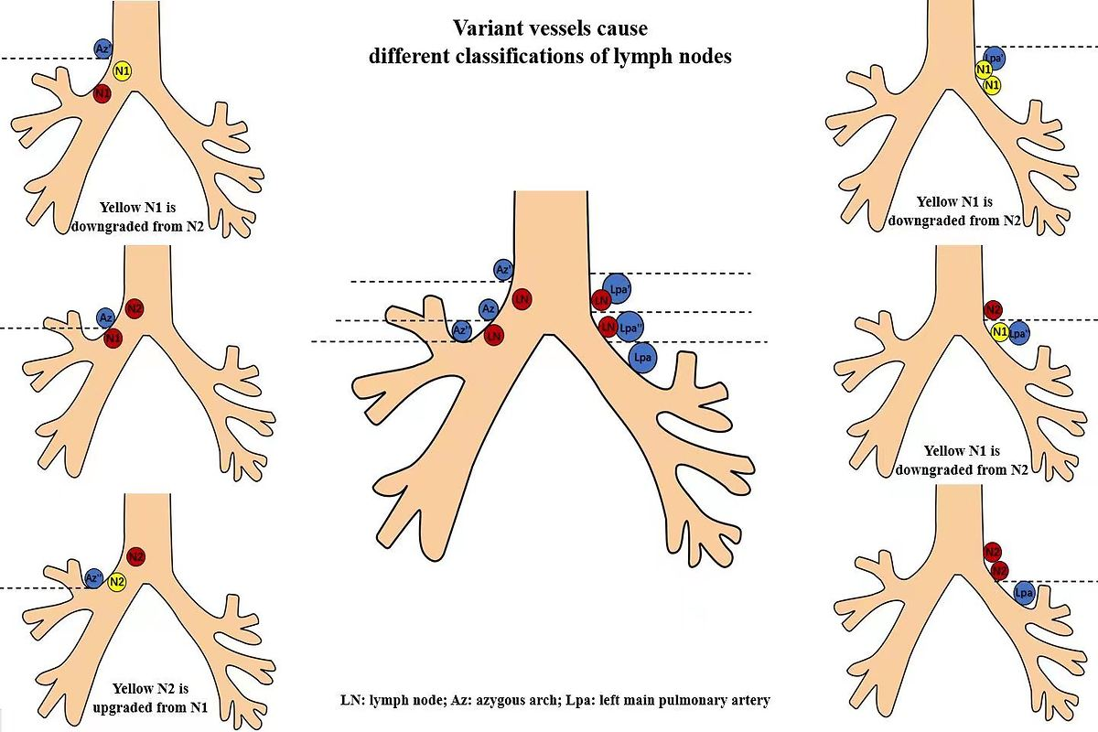

Demarcated by bronchial or vascular landmarks? a study on the lower borders of the lower paratracheal lymph nodes
DOI: 10.5114/aoms/161577
Notes:
Introduction
The lower rim of the azygous arch and the upper rim of the left main pulmonary artery are used as the lower borders of the lower paratracheal lymph nodes (LNs) in the IASLC map. However, there is some confusion about it. Our aim was to investigate the best landmarks as the boundaries to stage N more accurately for lung cancer.
Material and methods
One hundred patients with benign lung diseases, fifty with lung cancer diagnosed by endobronchial ultrasound-guided transbronchial needle aspiration (EBUS-TBNA), and thirteen with right metastatic LNs confirmed by surgery were included. The lymph nodes (including W1, W3, W5, 10R below W5, W4, W6) were classified with Wang's and IASLC map concurrently, and the different outcomes of N stage were compared.
Results
The azygous arch and the left main pulmonary artery varied in relation to the airway, causing the following changes of classification, 9.4% benign LNs of W1 and 38.6% of W5 were down-regulated as IASLC-10R, 9.5% of 10R below W5 were up-regulated as IASLC-4R, 51.4% of W4 and 94% of W6 were down-regulated as IASLC-10L. In 50 patients diagnosed by EBUS-TBNA, the concordance between the two maps was 0.768 for the right 92 LNs, while it was 0.374 for the left 46 nodes. If based on the location of azygous arches, postoperative stages might be changed in 2 surgery patients.
Conclusions
The locations of the lower vascular boundaries of IASCL-4 were varied. The bronchial landmarks of the proximal right and left main bronchus might be used as such borders.

