Slide 1
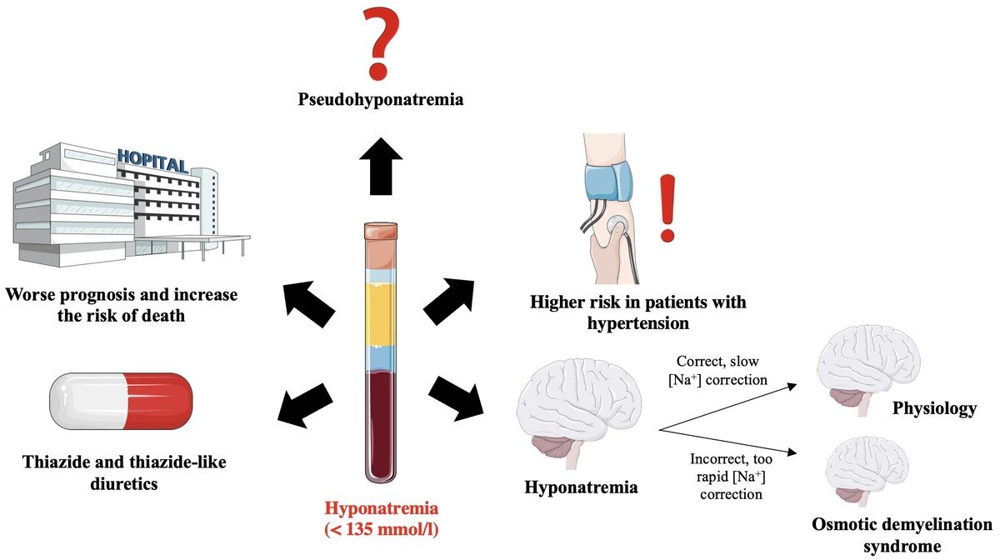

Hyponatremia in patients with arterial hypertension: pathophysiology and management
DOI: 10.5114/aoms/161578
Arch Med Sci 2023;19(6):1630-1645
Notes:
Sodium is the main cation in the extracellular space. In physiological conditions, sodium concentration in plasma is 135–145 mmol/l. The kidneys play the most important role in the regulation of sodium homeostasis. In recent years, a significant role of glycosaminoglycans, localized mainly in the subcutaneous tissue, and the role of glycocalyx on the surface of vascular endothelial cells, have been documented in the regulation of sodium metabolism. Hyponatremia is defined by a plasma sodium concentration lower than 135 mmol/l. Hyponatremia significantly worsens the prognosis of patients with different chronic diseases. In patients with arterial hypertension, the risk of hyponatremia is 1.5 times higher than in the general population. One of the causes of hyponatremia in patients with arterial hypertension is the use of thiazide or thiazide-like diuretics. The symptoms of hyponatremia are caused mainly by the swelling of cells in the central nervous system. Treatment of hyponatremia depends on the degree and duration (acute or chronic) of hyponatremia as well as presence of clinical symptoms. Too rapid correction of hyponatremia might result in a potentially fatal osmotic demyelinating syndrome. In the present review paper, pathophysiology and management of hyponatremia in patients with arterial hypertension are discussed.

