Slide 1
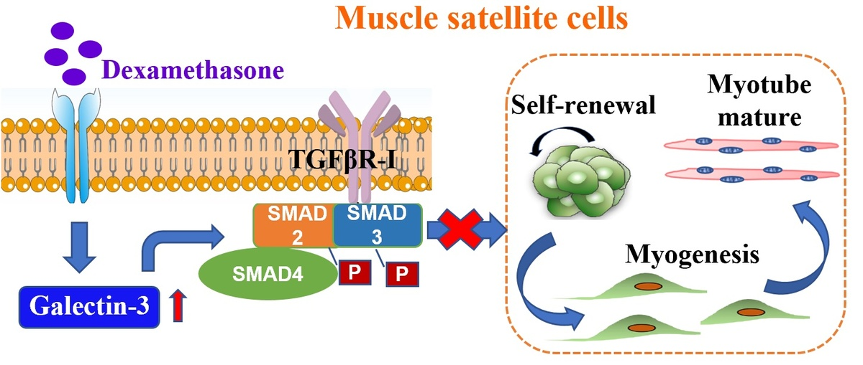

Galectin-3 regulates skeletal muscle loss via TGFβ1-Smad2/3 signaling activation in mice
DOI: 10.5114/aoms/161626
Notes:
Introduction
Endogenous glucocorticoids (GCs) played a pivotal role in the pathogenesis of skeletal muscle loss. However, to date, the underlying molecular mechanisms underlying are not yet fully understood. Galectin-3 (Gal-3) is a member of a beta-galactoside-binding animal lectins, consistently associated with inflammation and fibrosis in the pathogenesis of various disease states. The present study aimed to explore the role of Gal-3 in GC-induced skeletal muscle loss.
Material and methods
Myogenic differentiation capacity was detected after in vitro Gal-3 knockdown (KD) or in vivo administration of Gal-3 inhibitor. The activation of transforming growth factor type beta 1 (TGFβ1) and Smad2/3 signaling pathways was determined by western blot, co-immunoprecipitation, and immunofluorescence.
Results
Gal-3 was up-regulated during dexamethasone (Dex) administration in mice. In the established GC-induced muscle loss model, Gal-3 inhibition recovered grip strength and muscle mass. In vitro, Gal-3 KD promoted the myogenic differentiation capacity of C2C12 myoblasts, and prevented the reduction of fully differentiated myotubes. Gal-3 results in overexpression of TGFβ1 and TGFβR-I, which affects Smad2, 3 phosphorylation and subsequently mediates skeletal muscle reduction by activating the Smad2/3 signaling pathways.
Conclusions
The present study demonstrated that Dex elevated Gal-3 levels in skeletal muscle. Gal-3 facilitates the activation of TGFβ1-Smad2/3 signaling pathways in myoblasts, and contributes to myogenesis inhibition and skeletal muscle loss. This study raises awareness about the follow-up of patients receiving GC therapy. Further, inhibition of Gal-3 provides a possible therapeutic strategy for skeletal muscle loss.

