Slide 1
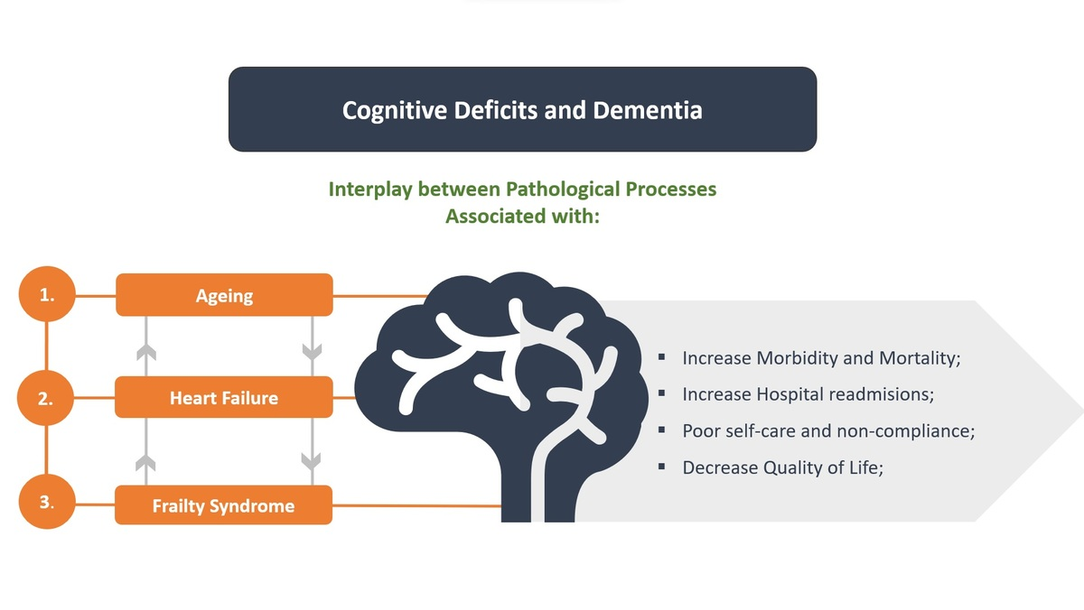

The concurrent impact of mild cognitive impairment and frailty syndrome in heart failure
DOI: 10.5114/aoms/162369
Arch Med Sci 2023;19(4):912-920
Notes:
Pathological processes associated with ageing increase the risk of cognitive deficits and dementia. Frailty syndrome, also known as weakness or reserve depletion syndrome, may significantly accelerate these pathological processes in the elderly population. Frailty syndrome is characterized by decreased physiological function and neuropsychiatric symptoms, including cognitive decline and depressive states. In people with cardiovascular disease, the risk of frailty is 3 times higher. Frailty syndrome is particularly prevalent in severe heart failure, which increases the risk of mortality, increases hospital readmission, and reduces patients’ quality of life. In addition, co-occurrence of cognitive impairment and frailty syndrome significantly increases the risk of dementia and other adverse outcomes, including mortality, in the heart failure population.

