Slide 1
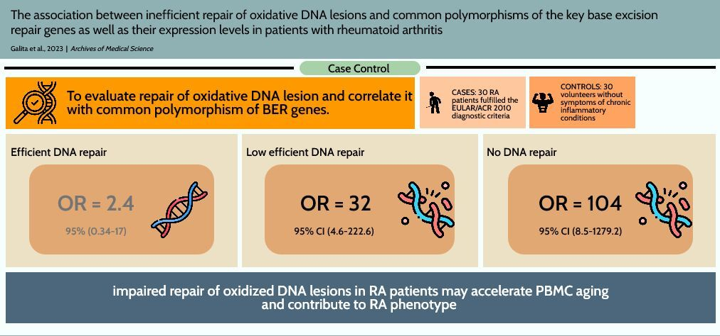

The association between inefficient repair of oxidative DNA lesions and common polymorphisms of the key base excision repair genes as well as their expression levels in patients with rheumatoid arthritis
DOI: 10.5114/aoms/163133
Arch Med Sci 2025;21(3):1010-1017
Notes:
Introduction
Rheumatoid arthritis (RA) is a common autoimmune heterogeneous joint disease of still unknown etiology. The pathology of RA leads to chronic inflammation of the joint tissues, which causes joint cartilage and bone destruction. One of the characteristic features of RA is oxidative stress, most likely induced and stimulated by inappropriate B- and T-cell activity. This results in accumulation of oxidative DNA lesions in peripheral blood mononuclear cells (PBMCs) isolated from RA patients, as we have shown previously. We have hypothesized that oxidative stress together with an impaired DNA damage response (DDR) to oxidative DNA lesions (limited to base excision repair pathway – BER) may be responsible for increased incidence in RA patients of some diseases with a background of genetic instability such as lymphoma and lung cancer.
Material and methods
Therefore, we determined the levels of oxidative DNA lesions and the kinetics of repair of DNA damage induced by tert-butyl hydroperoxide (TBH) in PBMCs of 30 RA patients and 30 healthy individuals. The metrics from the DNA damage and repair study were correlated with the genotypes of common polymorphisms of the key BER genes as well as their expression levels. DNA damage and repair were evaluated by alkaline single cell gel electrophoresis (comet assay), the genotypes of the polymorphism were determined by TaqMan SNP Genotyping Assay, and PrimeTime qPCR Assay was used to analyze the expression profile of genes related to BER.
Results
We observed an association between RA occurrence and impaired DNA repair in PBMCs. After stratifying the subjects by quartiles of DNA repair efficiency observed in the controls, we found an association between increased risk of RA and inefficient DNA repair (OR and 95% CI: 2.4 and 0.34–17, 32 and 4.6–222.6, 104 and 8.5–1279.2, for the 2nd to 4th quartiles, respectively, compared with the 1st quartile). We also identified interactions between inefficient DNA repair and polymorphism of the UNG gene (rs246079), and lower expression of key BER genes – MUTH, NEIL3 and UNG.
Conclusions
Our results suggest that the genetic variations within BER genes as well as epigenetic factors may be linked with RA by the modulation of the cellular response to oxidative stress. These polymorphisms may be a useful additional marker in this disease along with the genetic and/or environmental indicators of oxidative stress. However, these conclusions need to be validated in larger studies.

