Slide 1
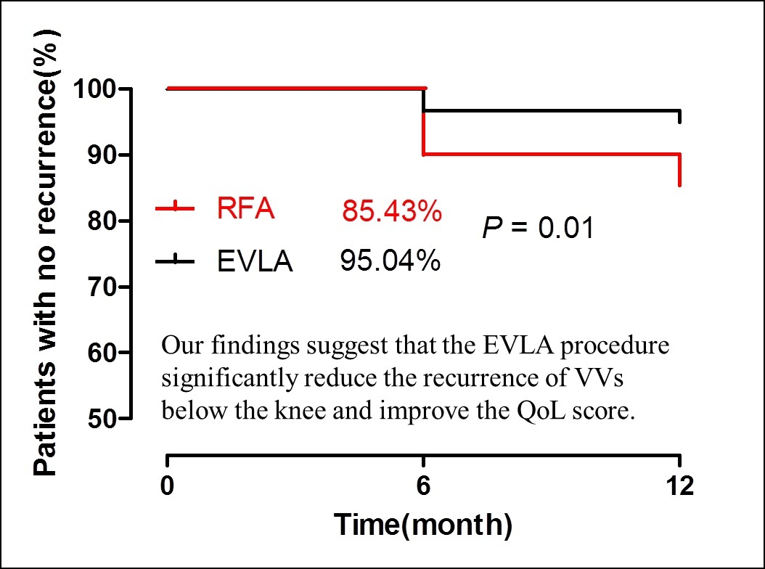

Hybrid endovenous laser ablation reduces the recurrence of varicose veins below the knee compared with radiofrequency ablation: a real-world study
DOI: 10.5114/aoms/163449
Arch Med Sci 2023;19(6):1739-1746
Notes:
Introduction
This study aimed to investigate the outcome of hybrid endovenous laser ablation (EVLA, 1470 nm) and radiofrequency ablation (RFA) procedures for varicose veins (VVs).
Material and methods
We retrospectively analysed the clinical data of patients from July 2019 to December 2020. Eighty-four patients (121 limbs) underwent a hybrid EVLA procedure, and 108 patients (151 limbs) underwent an RFA procedure. The outcomes, venous clinical severity score (VCSS), chronic venous disease quality-of-life questionnaire (CIVIQ-20) score, and recurrence at 1, 6, and 12 months were collected.
Results
No differences in complications or 24-h pain scores were noted between the 2 procedures, but a lower dosage of foam sclerosant was used in the EVLA procedure than in the RFA procedure (p < 0.02). The postoperative VCSS and CIVIQ-20 scores in the 2 groups were significantly decreased compared with the scores before the procedure, and no differences in scores were noted between the 2 procedures at 1 month. However, the VCSS and CIVIQ-20 scores for the EVLA procedure were significantly better than those for the RFA procedure at 6 and 12 months (p < 0.05). Both procedures showed a similar great saphenous vein closure rate at 12 months. The EVLA procedure showed lower rates of overall recurrence (4.96% vs. 14.57%, OR = 3.27, 95% CI: 1.33–8.00, p = 0.01) and recurrence below the knee (4.13% vs. 11.92%, OR = 3.14; 95% CI: 1.18–8.35, p = 0.02). Moreover, the patient satisfaction score was greater for the EVLA procedure than for the RFA procedure (p < 0.02).
Conclusions
The hybrid EVLA (1470 nm) procedure reduces VV recurrence below the knee and results in better quality-of-life scores.

