Slide 1
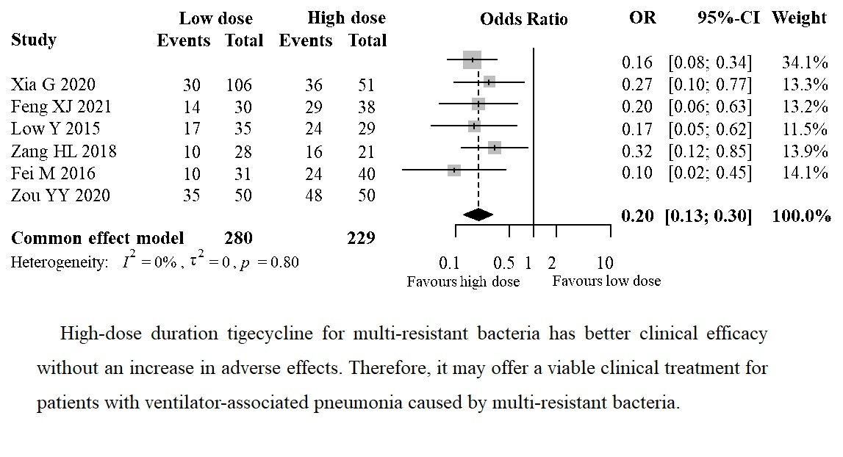

Efficacy and safety of tigecycline doses for ventilator-associated pneumonia caused by multiple resistant bacteria: a systematic review and meta-analysis
DOI: 10.5114/aoms/165833
Arch Med Sci 2025;21(3):883-888
Notes:
Introduction
Ventilator-associated pneumonia (VAP) caused by multi-resistant bacteria is a serious complication in hospitalized patients. Tigecycline, a broad-spectrum antibiotic, has been suggested as a potential treatment option for this condition, but the optimal dose of tigecycline remains unclear. In this study, we conducted a systematic review and meta-analysis to evaluate the efficacy and safety of different doses of tigecycline in the treatment of VAP caused by multi-resistant bacteria.
Material and methods
To identify relevant studies, we conducted a comprehensive search of multiple databases including the Cochrane Library, Embase, PubMed, the Chinese biomedical literature database, CNKI, Chinese JP, and WP, covering the period up to December 2022. The search strategy was designed to identify studies that evaluated the efficacy and safety of different doses of tigecycline in the treatment of ventilator-associated pneumonia caused by multi-resistant bacteria. We assessed the quality of the included studies using the Jadad quality score, and performed a meta-analysis of the data using Stata software.
Results
Six articles, consisting of a total of 509 patients, were included, with 280 patients in the control group (low-dose tigecycline) and 229 in the observation group (high-dose tigecycline). There was no clinical heterogeneity or statistical heterogeneity between studies (I<sup>2</sup><sup></sup> = 0%, p = 0.80), and a fixed-effect model was used to incorporate the effect size. The clinical effect of the observation group was significantly better than that of the control group (OR = 0.20, 95% CI: 0.13–0.30, p < 0.001). A meta-analysis of the adverse effects showed that there was no clinical heterogeneity or statistical heterogeneity between studies (I<sup>2</sup> = 51%, p = 0.10), and a fixed-effect model was used to incorporate the effect size. The incidence of adverse effects in the observed group was similar to that of the control group (OR = 0.96, 95% CI: 0.61–1.50, p = 0.85).
Conclusions
Duration of high-dose tigecycline treatment for ventilator-related pneumonia caused by multi-resistant bacteria is associated with improved clinical efficacy without an increase in adverse effects. Therefore, it may offer a viable treatment option for patients with ventilator-related pneumonia caused by multi-resistant bacteria.

