Slide 1
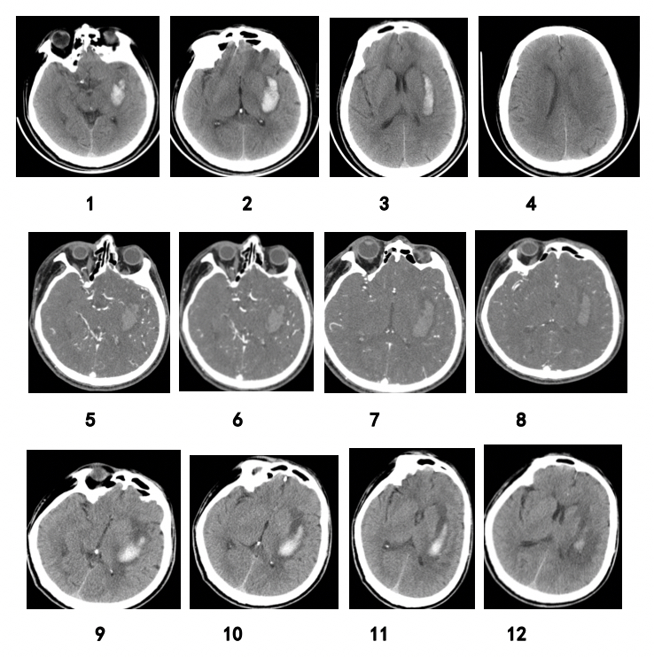

Predictive value of imaging manifestations of supratentorial hemorrhage in hematoma enlargement and clinical prognosis
DOI: 10.5114/aoms/165976
Notes:
Introduction
Intracerebral hemorrhage (ICH) is an important cause of death and disability. This study aimed to explore the imaging indicators identifying hematoma expansion in primary ICH and to provide a basis for its clinical treatment.
Material and methods
Hematoma expansion was evaluated by plain computed tomography (CT) scan and multi-detector-row CT angiography (MDCTA).
Results
This study included a total of 203 patients with intracerebral hemorrhage. The size of the hematoma at the time of admission was 32.5–92.3 ml (mean: 45.5 ml). Original or reconstructed MDCTA images with contrast extravasation were available in 35 (17.2%) cases. Patients were divided into two groups based on whether or not hematoma expansion had occurred: the hematoma expansion group (n = 87) and the no hematoma expansion group (n = 116). Percentages of patients with spot signs in the two groups were 37.93% and 3.45%, respectively, and percentages of those with spot sign ± blend sign ± black hole sign ± island sign (%) were 48.30% and 1.72%, respectively, with statistically significant differences. The sensitivity, specificity, and positive and negative predictive values of hematoma enlargement were 37.93%, 98.27%, and 94.29% and 67.86%, respectively. The sensitivity, specificity, and positive and negative predictive values of blend density sign ± irregular sign in predicting hematoma enlargement in ICH patients were 97.7%, 76.7%, and 75.9% and 97.8%, respectively.
Conclusions
Blend density sign ± irregular sign can be used as substitute signs. The more irregular and uneven density the hematoma, the more likely it is that the hematoma will be enlarged.

