Slide 1
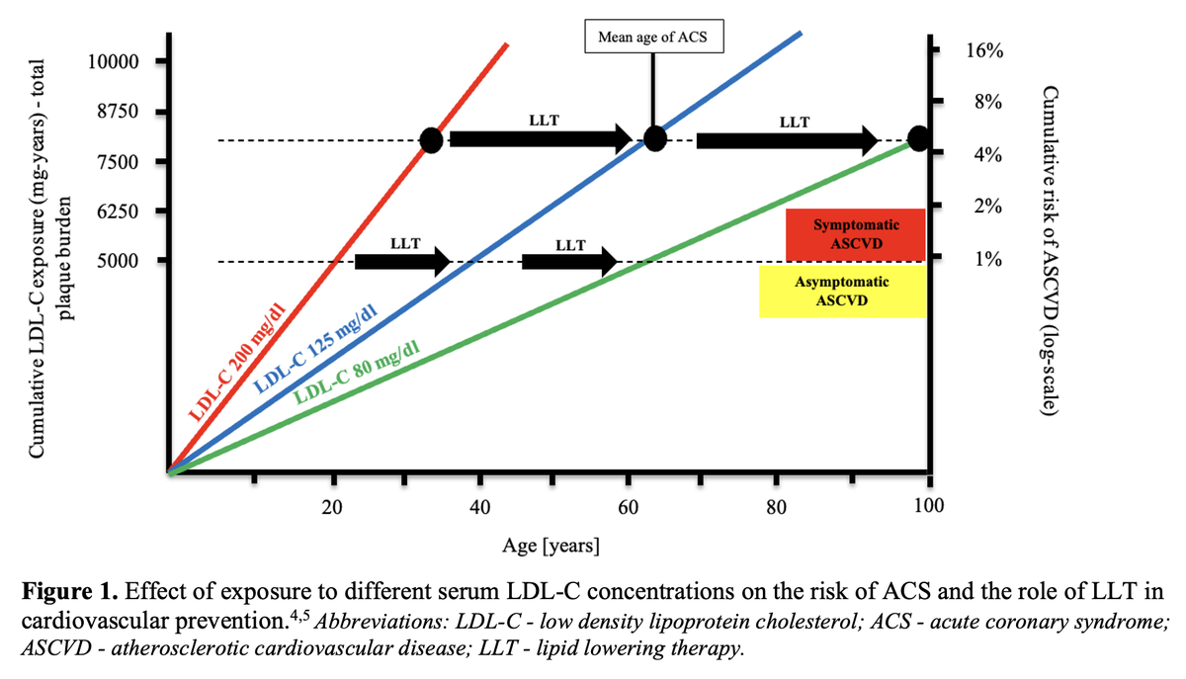

A look to the past – what has had the biggest impact on lipids in the last four decades? A personal perspective
DOI: 10.5114/aoms/166256
Arch Med Sci 2023;19(3):559-564

