Slide 1
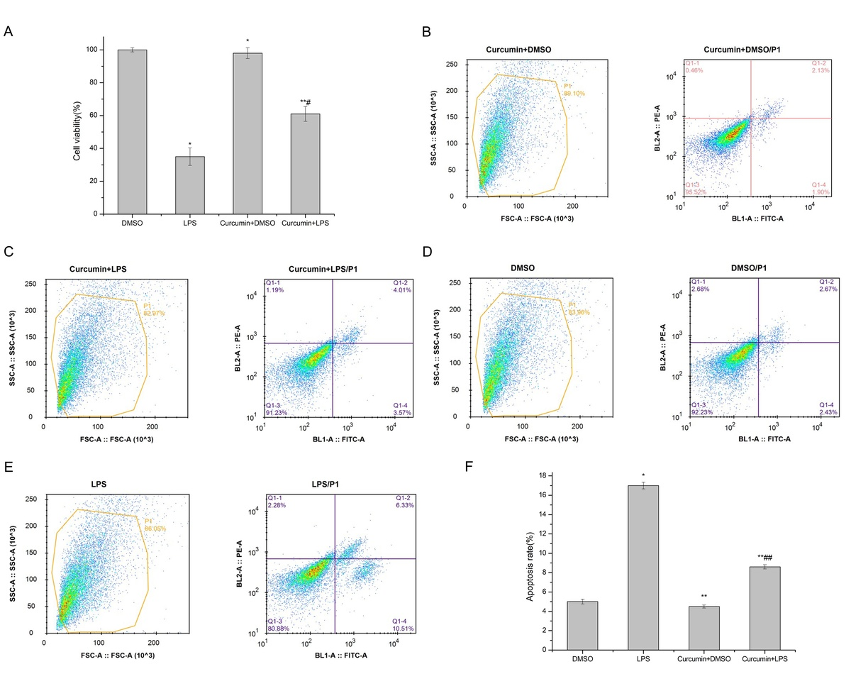

Curcumin inhibits lipopolysaccharide-induced proximal renal tubular epithelial cell death by regulating ADAMTS18 methylation and AKT/Notch pathways
DOI: 10.5114/aoms/167396
Arch Med Sci 2023;19(6):1822-1831
Notes:
Introduction
This study aimed to explore the effect of curcumin on the activity of lipopolysaccharide (LPS)-induced proximal renal tubular epithelial cells (PRTECs) and to analyze the molecular mechanism by which curcumin regulates their occurrence.
Material and methods
LPS-induced PRTECs were used to construct an inflammatory cell model. RT-qPCR and western blot (WB) were used to detect ADAMTS18 expression. Methylation-specific PCR was used to detect ADAMTS18 methylation levels. After curcumin treatment, MTT assay was used to analyze cell viability, flow cytometry was used to analyze apoptosis, and ADAMTS18 expression and methylation levels were detected again. After transfection with siADAMTS18, cell viability and apoptosis were analyzed again. The levels of inflammatory factors were measured by enzyme-linked immunosorbent assay, and the expression levels of AKT, Notch-1 and Notch-2 were analyzed by WB.
Results
Curcumin strongly inhibited LPS-induced PRTEC inflammatory lesions, restored normal cell proliferation, and reduced the apoptosis rate by downregulating ADAMTS18 methylation and restoring ADAMTS18 expression. After siADAMTS18, the ability of curcumin to improve cell viability was reduced, and the ability of curcumin to downregulate inflammatory factors was significantly reduced. Curcumin could also inhibit the expression of AKT, Notch-1 and Notch-2 simultaneously. siADAMTS18 attenuated the abovementioned effects of curcumin.
Conclusions
Curcumin inhibits LPS-induced PRTEC death by regulating ADAMTS18 methylation and AKT/Notch pathways.

