Slide 1
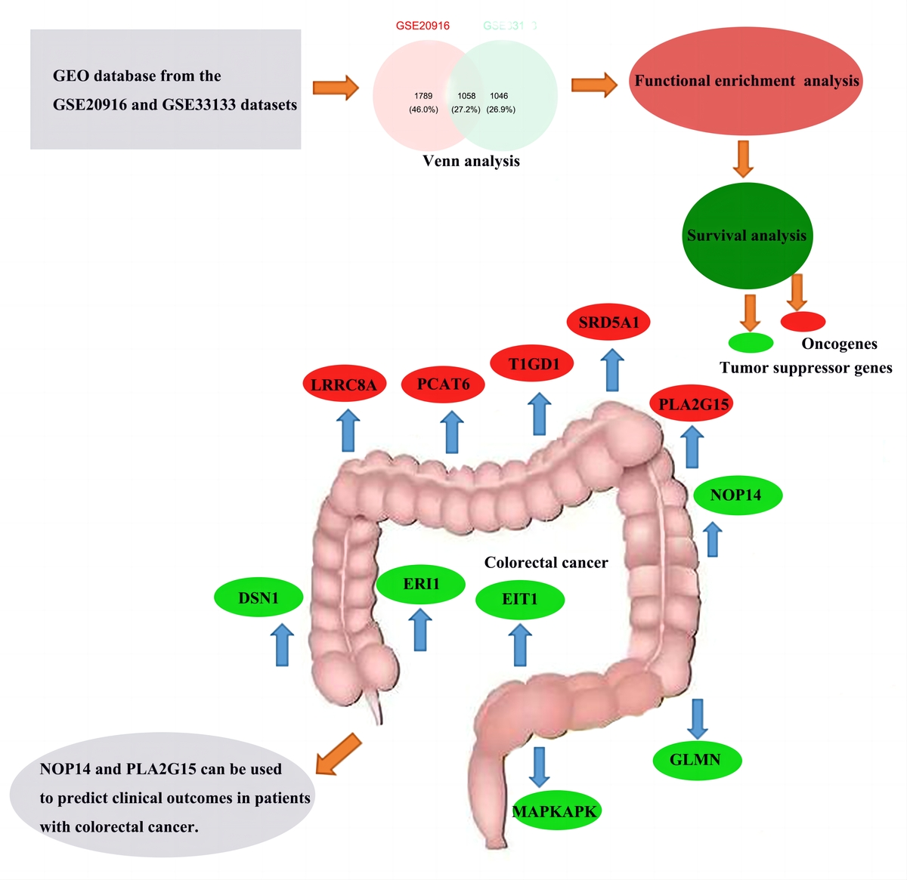

Investigation of potential prognostic biomarkers for colorectal cancer
DOI: 10.5114/aoms/167397
Arch Med Sci 2025;21(2):425-436
Notes:
Introduction
Colorectal cancer (CRC) is the third leading cause of cancer-related death. Since CRC is largely asymptomatic until the alert features develop to an advanced stage, implementation of a screening program is important to reduce cancer morbidity and mortality. Current screening methods have significant limitations.
Material and methods
CRC-related microarray datasets were collected from the GEO database and differentially expressed genes (DEGs) were identified. Next, Venn analysis, functional enrichment analysis, protein interaction network (PPI) analysis, and survival analysis were performed.
Results
A total of 5267 and 4233 DEGs were identified in two datasets (GSE20916, GSE33133). The intersection of up-regulated genes in the two datasets was obtained by Venn Analysis as 1058 DEGs. Among the 1058 genes, 992 genes with survival and clinical information in TCGA were screened. Eleven DEGs were identified as potential prognostic markers. Model results show that the time period with the most obvious prognostic effect is 5 years, and the AUC value is the highest. ROC curve results are consistent with the model results of the survival analysis. The survival curve showed that LRRC8A, PCAT6, PLA2G15, SRD5A1, T1GD1 may be oncogenes, and DSN1, ERI1, EIT1, GLMN, MAPKAPK, NOP14 may be tumor suppressor genes.
Conclusions
This study discovers novel prognostic markers through Cox regression and survival analysis, and provides a theoretical basis for the treatment of CRC.

