Slide 1
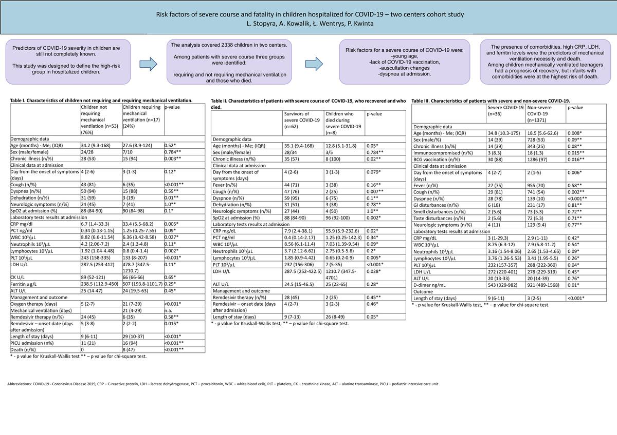

Risk factors of severe course and fatality in children hospitalized for COVID-19: a two-center cohort study
DOI: 10.5114/aoms/167398
Arch Med Sci 2025;21(3):828-835
Notes:
Introduction
After 3 years of the pandemic, predictors of COVID-19 severity in children are still not completely known. This study was designed to define the high-risk group in hospitalized children.
Material and methods
The analysis covered 2338 children in two centers. Among patients with a severe course, three groups were identified: requiring and not requiring mechanical ventilation, and those who died.
Results
The median age of 70 children (54% female) with severe COVID-19 was 32 months. In 43 (61%) children, comorbidities were present. No one was vaccinated against COVID-19. On admission, medium SpO2 was 89%. Sixty-five (93%) patients presented with dyspnea, and 49 (70%) with cough. Fifty-three (76%) children required noninvasive oxygen support and 17 (24%) mechanical ventilation. Eight (11%) children died. The most significant difference between mechanically ventilated children who recovered and those who died was age – 124 vs, 12.8 months (p < 0.001). Children requiring mechanical ventilation presented higher C-reactive protein (CRP) (median 33.4 vs. 6.7 mg/dl), lactate dehydrogenase (LDH), and ferritin. In children who died even higher CRP (55.9 vs. 7.9 mg/dl), deep lymphopenia (0.65 vs. 1.85 × 103/µl), and thrombocytopenia (7 vs. 237 × 103/µl) were observed.
Conclusions
Risk factors for a severe course of COVID-19 were: young age, lack of COVID-19 vaccination, auscultation changes and dyspnea at admission. The presence of comorbidities, high CRP, LDH, and ferritin levels were the predictors of need for mechanical ventilation and death. Among children mechanically ventilated, teenagers generally had a favorable prognosis of recovery, whereas infants with comorbidities were at the highest risk of death.

