Slide 1
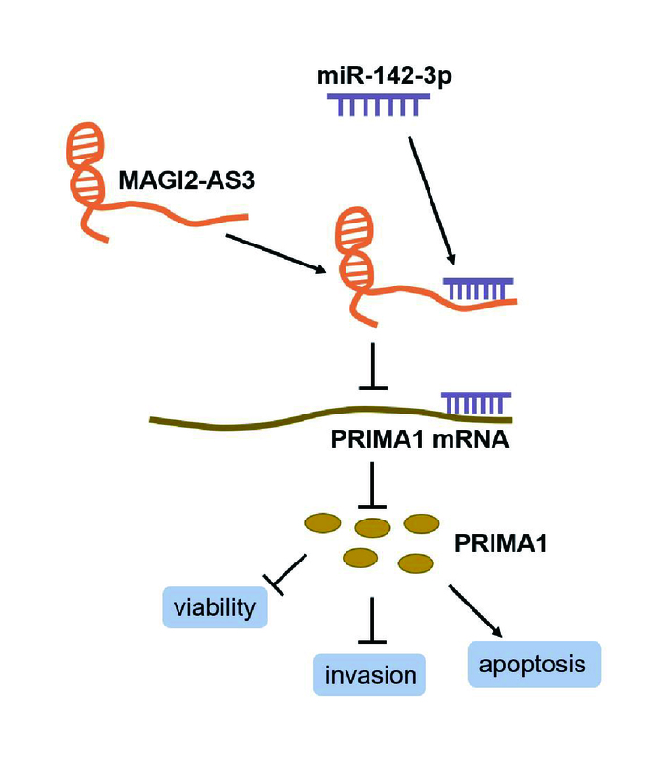

MAGI2 antisense RNA 3 (MAGI2-AS3) knockdown contributes to prostate cancer by downregulating proline-rich membrane anchor 1 (PRIMA1) via miR-142-3p
DOI: 10.5114/aoms/167431
Notes:
Introduction
Long non-coding RNA Membrane-Associated Guanylate Kinase Inverted 2 Antisense RNA 3 (MAGI2-AS3) has been identified as a predictive characteristic for prostate cancer (PC). However, the underlying mechanism of MAGI2-AS3 in PC is yet unclear.
Material and methods
The gene expression was detected via reverse transcription quantitative PCR. Cell viability, apoptosis and invasion were detected via cell counting kit-8, caspase-3 activity, flow cytometry, and transwell assays. Tumor xenograft experiment was performed to measure the tumor growth in vivo. Luciferase and radioimmunoprecipitation assays were utilized to determine the association between microRNA (miR)-142-3p and MAGI2-AS3 or proline-rich membrane anchor 1 (PRIMA1).
Results
MAGI2-AS3 and PRIMA1 were established to be downregulated in PC, whereas miR-142-3p exhibited the upregulation in PC. In vitro and in vivo loss-of-function assays demonstrated that MAGI2-AS3 silencing increased the viability and invasiveness, enhanced the tumor growth of PC cells, while reducing apoptosis. PRIMA1 silencing in PC cells showed the similar effect as MAGI2-AS3 silencing. Moreover, the miR-142-3p inhibitor reversed the impacts of the downregulation of MAGI2-AS3 or PRIMA1 on the malignant behavior of PC cells.
Conclusions
MAGI2-AS3 knockdown enhanced the malignant behavior of PC cells by targeting miR-142-3p to suppress PRIMA1 expression. Our findings reveal that MAGI2-AS3 can be a promising therapeutic target for the treatment of PC.

