Slide 1
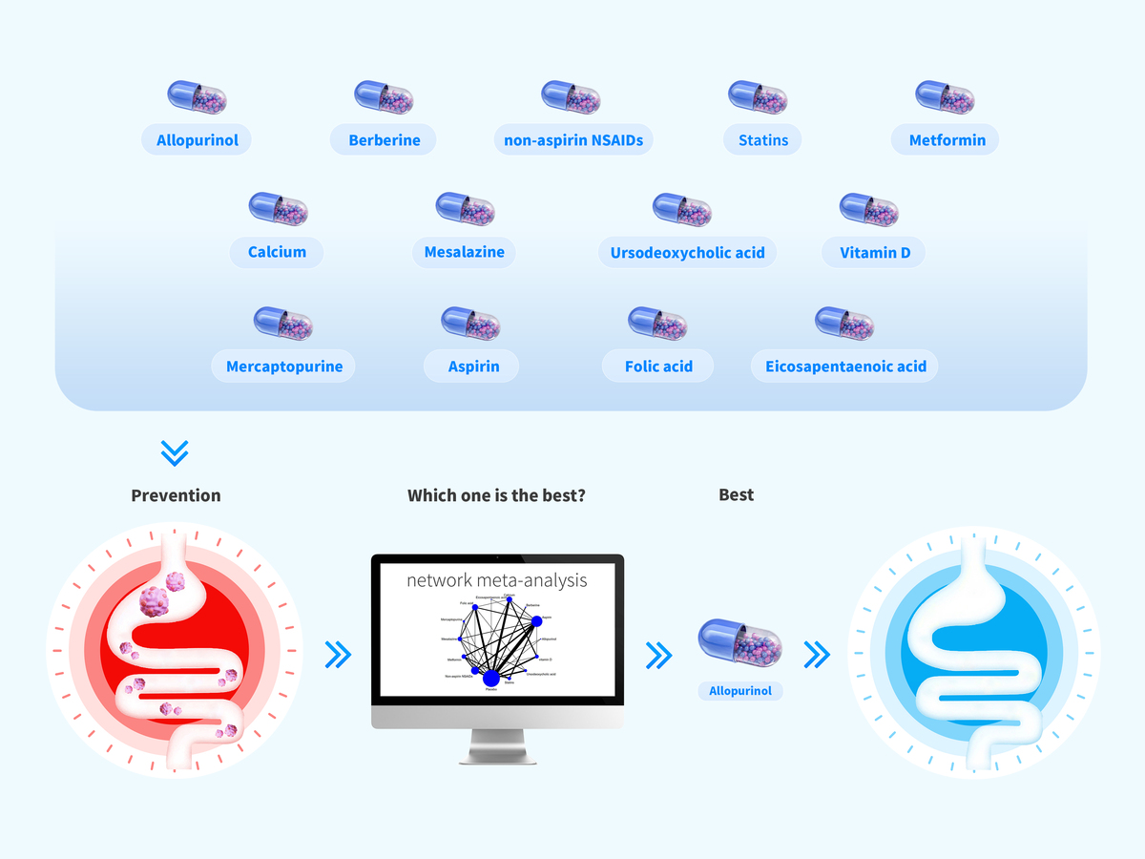

Preventive effects of 13 different drugs on colorectal cancer: a network meta-analysis
DOI: 10.5114/aoms/167480
Arch Med Sci 2023;19(5):1428-1445
Notes:
Introduction
The aim of the study was to evaluate the preventive effect of 13 drugs on colorectal cancer (CRC) and guide the clinical application of these drugs.
Material and Methods
PubMed, Web of Science, Embase, Cochrane Library, and China National Knowledge Infrastructure were searched for randomized controlled trials (RCTs) and cohort studies. The Cochrane bias risk assessment tool and the Newcastle-Ottawa Scale quality evaluation tool were used to evaluate the quality of the included RCTs and cohort studies. The funnel plot was used to analyze publication bias. A network meta-analysis of the extracted data was conducted using Stata16.0 software.
Results
A total of 57 studies (34 RCTs and 23 cohort studies) involving 82719 participants were included. The network meta-analysis revealed that the quality of the included studies was good; the funnel plot showed no obvious publication bias. The network meta-analysis showed that the preventive effect of 13 drugs on CRC was better than that of the placebo. Allopurinol (SUCRA: 97.2%) was found to have the best effect, followed by berberine (SUCRA: 89.9%), non-aspirin NSAIDs (SUCRA: 84.5%), statins (SUCRA: 66.5%), metformin (SUCRA: 66.3%), calcium (SUCRA: 48.9%), mesalazine (SUCRA: 44.5%), ursodeoxycholic acid (SUCRA: 42.6%), vitamin D (SUCRA: 41.4%), mercaptopurine (SUCRA: 39.4%), aspirin (SUCRA: 30.4%), folic acid (SUCRA: 24.9%), and eicosapentaenoic acid (SUCRA: 16.3%).
Conclusions
The preventive effect of allopurinol on CRC was better than that of the other 13 drugs. These results can help doctors and patients understand the preventative effects of these drugs more intuitively and provide an evidence-based basis for the clinical application of these drugs.

