Slide 1
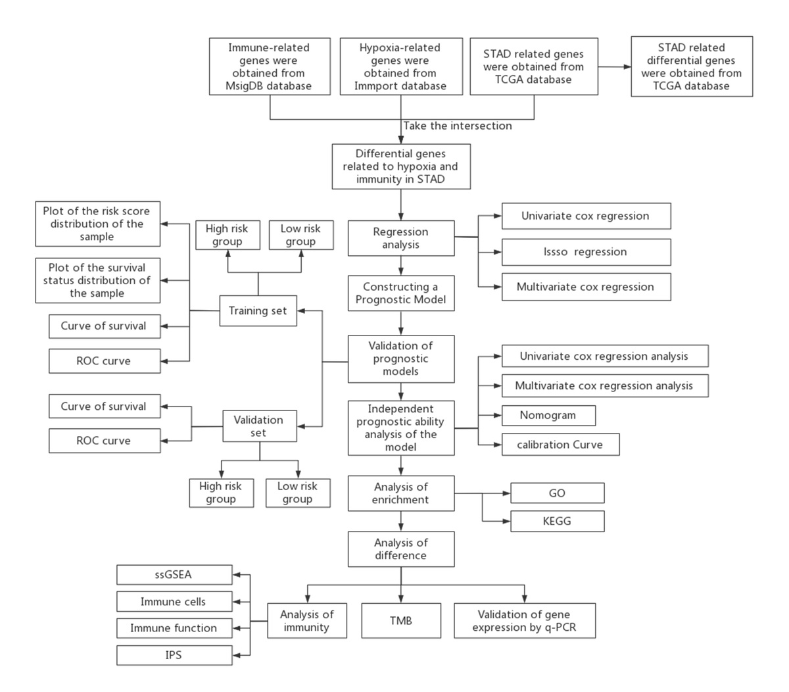

A prognostic model for stomach adenocarcinoma based on hypoxia- and immune-related genes
DOI: 10.5114/aoms/167481
Arch Med Sci 2025;21(3):1018-1035
Notes:
Introduction
Characterized by vast heterogeneity, gastric cancer (GC) is one of the leading causes of cancer-related deaths. A specific prognostic model is necessary for the improvement of clinical treatment strategies. Hypoxia is a common feature in the tumor microenvironment that promotes tumor progression. However, the current evaluation of the hypoxic tumor immune microenvironment in GC is still inadequate.
Material and methods
With sequence data and single nucleotide variants data obtained from The Cancer Genome Atlas-STAD dataset as well as hypo­xia- and immune-related genes acquired from MsigDB and ImmPort, a hypoxia-immune-based gene signature of stomach adenocarcinoma (STAD) was built by Cox regression analysis. The risk score could be used as an independent prognostic factor.
Results
The receiver operating characteristic curve and survival curve showed the accuracy of the model. Pearson correlation analysis showed that DUSP1, one of the hypoxia- and immune-related feature genes, was positively correlated with immune cell scores and immune-related function scores. In addition, low-risk group peers were found to be in higher immune infiltration status and had a higher immunophenoscore as demonstrated by single-sample Gene Set Enrichment Analysis (GSEA), indicating a better response to immune checkpoint inhibitor (ICI) treatment among the low-risk group. q-PCR results showed that DUSP1, IGFBP1, CGB5, GPC3 and EGF were significantly highly expressed in STAD cells, while FAM3D and FGF8 were significantly down-regulated.
Conclusions
Overall, our study not only paves the way for future studies focusing on hypoxia and the immune microenvironment but also improves STAD patients’ prognosis and their response to immunotherapy.

