Slide 1
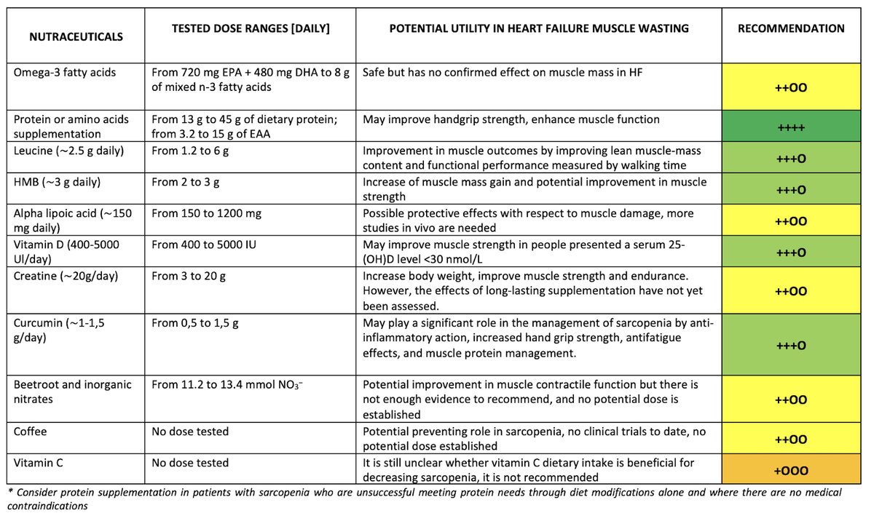

The role of nutraceuticals in heart failure muscle wasting as a result of inflammatory activity. The International Lipid Expert Panel (ILEP) Position Paper.
DOI: 10.5114/aoms/167799
Arch Med Sci 2023;19(4):841-864
Notes:
Muscle wasting is one of the main causes for exercise intolerance and ventilatory inefficiency in patients with heart failure and a strong predictor of frailty and reduced survival. The prevalence of sarcopenia is at least 20% in patients with heart failure. Patients with heart failure often have subclinical systemic inflammation, which may exert sustained effects on skeletal muscle. Besides exercise, nutrition should also be carefully evaluated as an appropriate diet with selected nutraceuticals may be able to stimulate muscle anabolism and inhibit muscle catabolism. This review summarizes the epidemiological and clinical trial evidence supporting the recommendations for the use of nutraceuticals with anti-inflammatory properties in heart failure and provides an overview of the state of the evidence for nutraceutical supplementation to prevent and/or mitigate heart failure muscle wasting.

