Slide 1
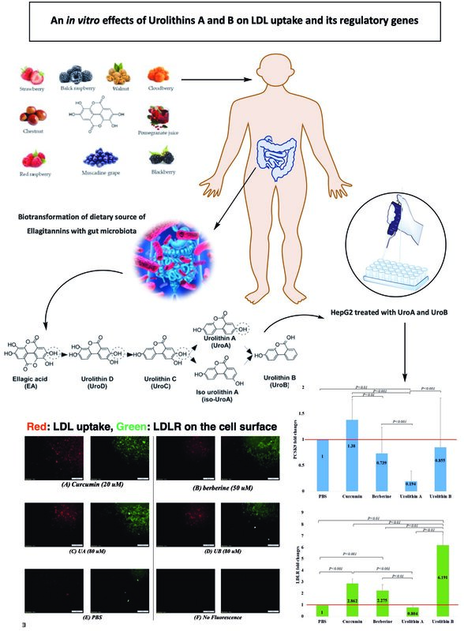

An <i>in vitro</i> investigation of the effects of urolithins A and B on low-density lipoprotein uptake and its regulatory genes
DOI: 10.5114/aoms/168120
Arch Med Sci 2023;19(6):1832-1841
Notes:
Introduction
This study aimed to evaluate the possible role of urolithin A (UA) and urolithin B (UB) on the mRNA expression levels of LDL receptor (LDLR) and PSCK9 genes, and also of the uptake of LDL particles in HepG2 cells.
Material and methods
The potential role of UA and UB on the induction of LDL uptake and the expression of its regulatory genes was explored using HepG2 cells and curcumin (20 µM), berberine (50 µM), UA (80 µM), and UB (80 µM) as the treatments in the experimental tests.
Results
The LDL uptake and cell-surface LDLR were higher in cells treated with UA in comparison with cells treated with UB, and even in relation to the cells treated with curcumin and berberine as positive controls. In addition, cells treated with UB showed approximately 2 times greater LDLR expression levels compared with curcumin (FC = 2.144, p = 0.013) and berberine (FC = 2.761, p = 0.006). However, UA treatment resulted in significantly lower expression levels of LDLR compared with curcumin (FC = 0.274, p < 0.001) and berberine (FC = 0.352, p = 0.009). UB demonstrated approximately 8 times higher LDLR expression levels when compared with UA (FC = 7.835, p = 0.001). Compared with UB, as well as curcumin and berberine as positive controls, UA was more efficient in reducing PCSK9 expression levels. Although UB did not show any significant differences compared with curcumin and berberine, it showed higher levels of PCSK9 expression when compared with the UA group (FC = 3.694, p < 0.001).
Conclusions
The present results suggest that UA was more effective than UB in promoting LDL uptake as well as cell surface LDLR in HepG2 cells. This effect seems to be mostly mediated through the suppression of PCSK9 expression but not the induction of LDLR expression.

